Slide 1

Scorecard Development
24-10-2022 Zening Zheng

Slide 2

Contents
Overview
Final Model + Features + Deployment
Approach
Conclusions & Recommendations

Slide 3
Overview
1
Goal
Approach
Data exploration & cleaning
Descriptive analysis
Data quality check
Convert data to right format, Imputation of missing value, outlier
Variable selection (statistics & expert-based)
Information value
Binning – reduce dimensionality
Transform variables to WOE score
Multicollinearity – remove highly correlated variables
Lasso regression - penalize complexity
Expert
Testing
Split data, oversampling technique
Modeling
Logistic regression
Decision tree
Gini
Scorecard development
Automate credit scoring process
Select important features
Built credit scorecard
Notes:
weight of evidence

Slide 4
2 Final Model
Logistic regression

Slide 5
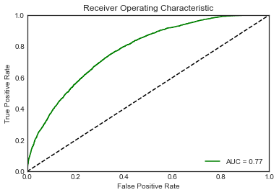
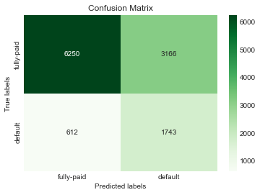
2
Final Model
Model: logistic regression
Features : 13
['term', 'installment', 'int_rate', 'home_ownership','annual_inc', 'verification_status', 'addr_state', 'dti', 'fico_range_high', 'revol_util', 'mort_acc', 'age', 'pay_status', 'loan_amnt' ]
Criteria | Value
GINI | 0.54
R squared | 0.68
Precision | 0.63
Recall | 0.69
F-1 score | 0.62

Slide 6
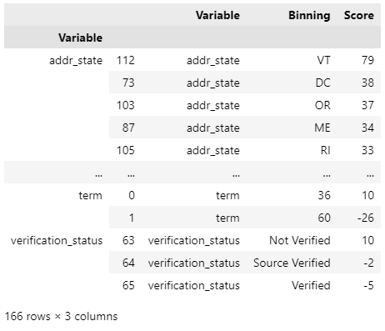
2
Final Model - deployment

Slide 7
3 Approach
Data exploration & cleaning
Variable selection (statistics & expert-based)
Testing
Scorecard development

Slide 8
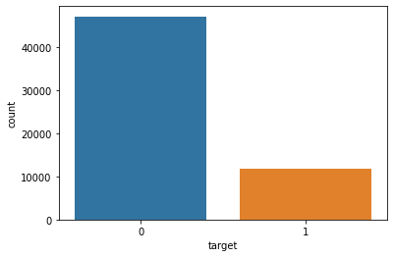
3
Approach - Data exploration & cleaning
Default rate: 0.2
number of default: 11772
number of non-default: 47080
Drop: loan_status_2, issue_d
Transform: pay_status (-2,-1 = pay duly)

Slide 9
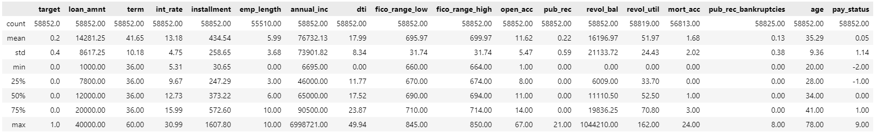
3
Approach - Data exploration & cleaning
Descriptive analysis

Slide 10
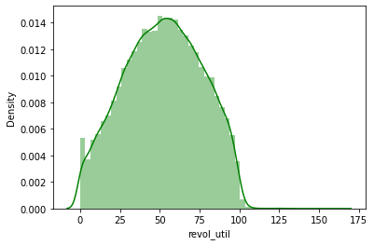
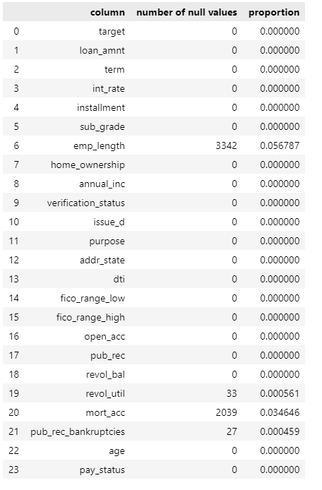
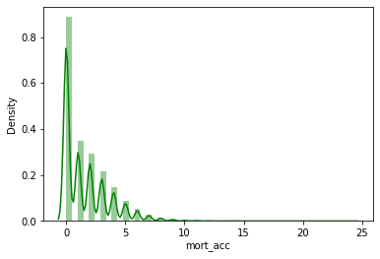
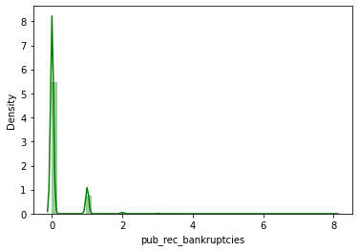
3
Approach - Data exploration & cleaning
Missing value
Emp_length –left for binning
revol_util – mean
mort_acc – 0
pub_rec_bankruptcies
Outlier - binning

Slide 11
3
Approach - Variable selection
Benefits of Using WoE transformation
It can treat outliers.
It can handle missing values as missing values can be binned separately.
Since WOE Transformation handles categorical variable so there is no need for dummy variables.
WoE transformation helps you to build strict linear relationship with log odds. Otherwise it is not easy to accomplish linear relationship using other transformation methods such as log, square-root etc.
Information Value (IV) comes from information theory, it measures the predictive power of independent variables

Slide 12
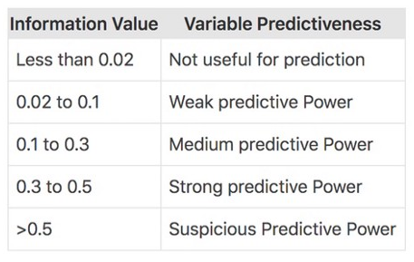
3
Approach - Variable selection
Binning: Numeric -> 10 bins
Transform to Woe value
Information value: >0.02
Final variables: 16
['loan_amnt', 'term', 'int_rate', 'installment', 'sub_grade', 'home_ownership','annual_inc', 'verification_status', 'addr_state', 'dti','fico_range_low', 'fico_range_high', 'revol_util', 'mort_acc', 'age', 'pay_status' ]
Notes:
Information Value (IV) comes from information theory, it measures the predictive power of independent variables

Slide 13
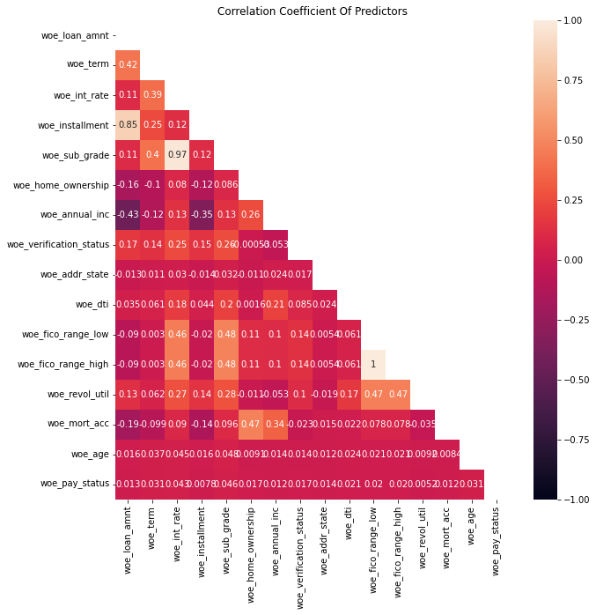
3
Approach - Variable selection
Multicollinearity
VIF>5
Variables with high correlation:
'installment', 'loan_amnt’,
'sub_grade’, 'int_rate’,
'fico_range_high’, 'fico_range_low'

Slide 14
3
Approach - Variable selection
Lasso - penalize complexity, coefficient equal to 0
No need to drop any variables

Slide 15
3
Approach - Variable selection
Final features: 13
['term', 'installment', 'int_rate', 'home_ownership','annual_inc', 'verification_status', 'addr_state', 'dti', 'fico_range_high', 'revol_util', 'mort_acc', 'age', 'pay_status', 'loan_amnt' ]

Slide 16
3
Approach – testing, model comparison
Split data (0.2-0.8)
Oversampling (SMOTE)
Modeling
Logistic regression
Decision tree

Slide 17
3
Approach – testing
Criteria | Logistic - Value | Decision tree value
GINI | 0.54 | 0.54
R squared | 0.68 | 0.72
Precision | 0.63 | 0.59
Recall | 0.69 | 0.58
F-1 score | 0.62 | 0.58
Accuracy | 0.54 | 0.72

Slide 18
3
Approach – scorecard development
Scorecard
Score = (β×WoE+ α/n)×Factor + Offset/n
odds of 1:1 at 650 points and the pdo of 50 (odds to double every 20 points)
Need further validation of the model
Notes:
Where: βi — logistic regression coefficient for the variable Xi α — logistic regression intercept WoE — Weight of Evidence value for variable Xi n — number of independent variable Xi in the model
Factor, Offset — known as scaling parameter, where
Factor = pdo/ln(2) -> B
Offset = Target Score — (Factor × ln(Target Odds))
a scorecard has the base odds of 1:1 at 650 points and the pdo of 50 (odds to double every 20 points)

Slide 19
4 Conclusions & Recommendations

Slide 20
4
Conclusions & Recommendations
Conclusions
13 final Variables
Gini : 0.54
Recommendations
Date variable, outlier
Customized bin for each variable
Combine categories with similar woe
More models

